Slide 1

Bahria University Karachi Campus
Data Mining
Department of Software Engineering
Bahria University Karachi Campus

Slide 2
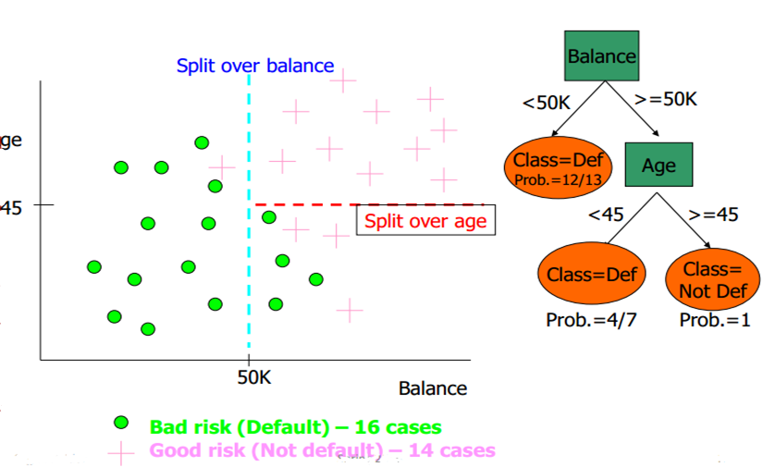
Geometric interpretation of model
A

Slide 3
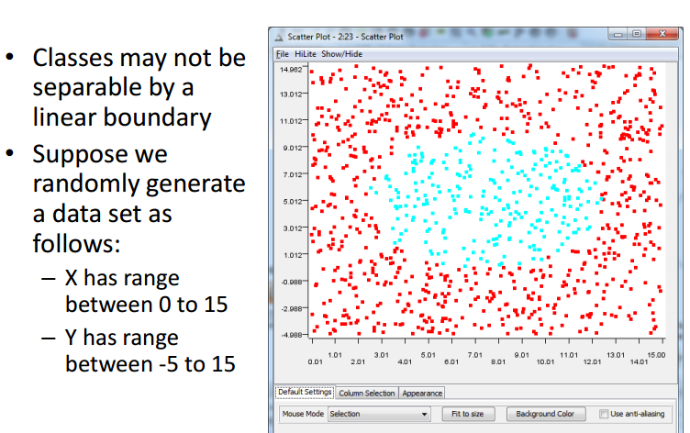
Nonlinear Classification

Slide 4
Naïve Bayes
Naïve Bayes classifiers assume that the effect of an attribute value on a given class is independent of the values of the other attributes.
This assumption is called class conditional independence.
It is made to simplify the computations involved and, in this sense, is considered “naïve”.
Notes:
https://www.youtube.com/watch?v=RixQygYyDKI

Slide 5
Naïve Bayes Classifier
Assume independence among attributes X_{i} when class is given:
P(X₁, X₂, …, X_{d} |Y_{j}) = P(X₁| Y_{j}) P(X₂| Y_{j})… P(X_{d}| Y_{j})
Now we can estimate P(X_{i}| Y_{j}) for all X_{i} and Y_{j} combinations from the training data
New point is classified to Y_{j} if P(Y_{j}) Π P(X_{i}| Y_{j}) is maximal.
Notes:
Chap_4 >Slide 8

Slide 6
Naïve Bayes on Example Data
Given a Test Record:
P(X | Yes) =
P(Refund = No | Yes) x
P(Divorced | Yes) x
P(Income = 120K | Yes)
P(X | No) =
P(Refund = No | No) x
P(Divorced | No) x
P(Income = 120K | No)

Slide 7
Estimate Probabilities from Data
Class: P(Y) = N_{c}/N
e.g., P(No) = 7/10, P(Yes) = 3/10
For categorical attributes: P(X_{i} | Y_{k}) = |X_{ik}|/ N_{c}
where |X_{ik}| is number of instances having attribute value X_{i} and belonging to class Y_{k}
Examples:
P(Status=Married|No) = 4/7 P(Refund=Yes|Yes)=0
k

Slide 8
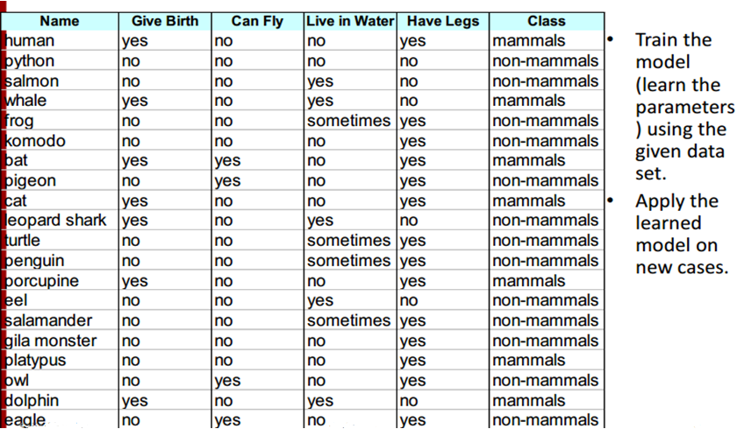
Naïve Bayes Classification: Mammals vs. Non-Mammal

Slide 9
Example of Naïve Bayes Classifier
A: attributes
M: mammals = 7
N: non-mammals =13
P(A|M)P(M) > P(A|N)P(N)
=> Mammals
A

Slide 10
Cont…
Probability ratio given in %:
P(M)+P(N) = 0.021 + 0.0027
= 0.0237
P(M) = 0.021/0.0237
= 0.886 = 88.6%
P(N) = 0.0027/0.0237
= 0.011 = 11%

Slide 11
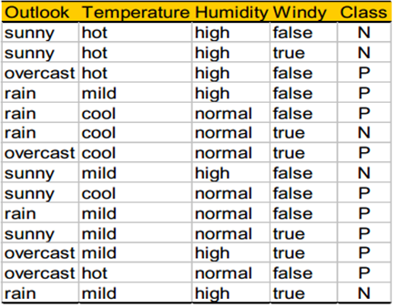

Example: Play Tennis
3
Notes:
P= play , N=Not play

Slide 12
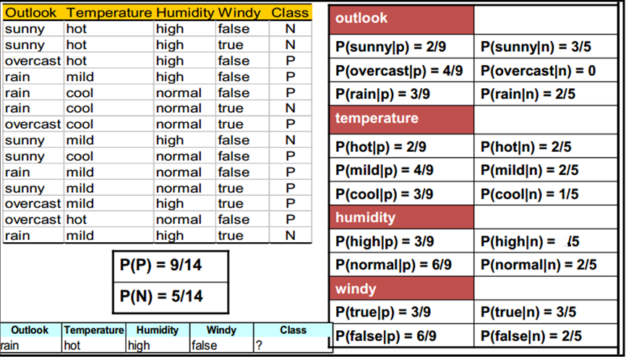
Example: Play Tennis
3
Notes:
P= play , N=Not play

Slide 13
Cont…
3

Slide 14
P(P)+P(N) = 0.010 + 0.013 = 0.0237
P(P) = 0.010/0.023 = 0.434 = 43.5% PLAY TENNIS
P(N) = 0.013/0.023 = 0.565 = 56.5% DO NOT PLAY TENNIS

Slide 15
Characteristics of Naïve Bayes Classifiers
They are robust to isolated noise points because such points are averaged out when estimating conditional probabilities from data.
Naïve Bayes classifiers can also handle missing values by ignoring the example during model building and classification.
They are robust to irrelevant attributes. If Xi is an irrelevant attribute, then P(Xi | Y) becomes almost uniformly distributed.
Correlated attributes can degrade the performance of naïve Bayes classifiers because the conditional independence assumption no longer holds for such attributes.

Slide 16
How Effective are Bayesian Classifiers?
Various empirical studies of this classifier in comparison to decision tree and neural network classifiers have found it to be comparable in some domain.
In theory, Bayesian classifiers have the minimum error rate in comparison to all other classifiers.
However, in practice this is not always the case, owning to inaccuracies in the assumptions made of its use, such as class conditional independence, and the lack of available probability data.

